Slide 1
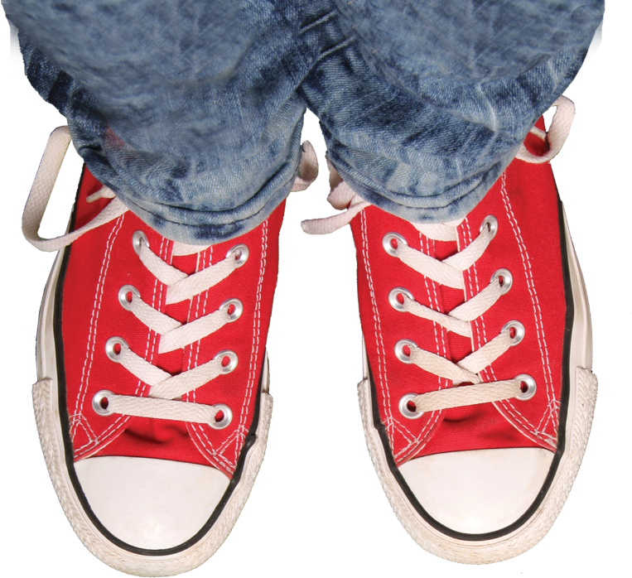
Raising Teens
in the 21st Century
James G. Wellborn, Ph.D.

Slide 2
When A Friend Dies:
Helping Teens Grieve
James G. Wellborn, Ph.D.

Slide 3
How Kids React
Shock
Disbelief
Sadness
Anger
Confusion
Numbness
Regret
Guilt
Fear
Minimization and Denial
Loneliness and Feeling Alone
Dreaming
Redefining Normality
www.DrJamesWellborn.com

Slide 4
When It’s a Friend
Guilt
Anxiety
Alone & Abandoned
Delayed reaction
Fear of moving on
Check for depression and suicide risk
It affects parents too
www.DrJamesWellborn.com

Slide 5
What’s a parent to do?
www.DrJamesWellborn.com

Slide 6
Educate Them
Help them understand grief & mourning
Acceptance
Facing the pain
Making sense of death
Dealing with the absence of the person
Moving forward with life
Finding a psychological place for the deceased
Model grief & mourning
Share stories and your own beliefs
www.DrJamesWellborn.com

Slide 7
Dealing with it
Exercise
Treat your body and mind like it is stressed out
Spend time around people
Do something enjoyable
Keep your routines
Expect to have set backs
Keep a journal
Pay attention if you start to do risky things
Have something that reminds you of your friend
www.DrJamesWellborn.com

Slide 8
Helping Family & Friends
Hugs
Cry with them if you feel like it
Avoid saying “It’s God’s will.”
Don’t ask them how they are doing
Be there. Help out.
Say their name out loud
Share memories
www.DrJamesWellborn.com

Slide 9
Reassure And Comfort Them
Talk and remember
Faith
Give permission to grieve
Encourage them to take time to consider the BIG questions
Your kid may not be very upset
Encourage them to reach out to others
Bear witness to their grief
Keep an eye on your kid for 6 months or so
If their reaction is out of proportion, look deeper
www.DrJamesWellborn.com

Slide 10
Signs of Unresolved Grief
Depression
Thoughts of dying or suicide
Pessimism and living for the moment at the expense of important life tasks like school, hobbies, relationships.
Inability to talk about the deceased without becoming overcome with emotion.
Attempts to preserve articles belonging to or associated with the deceased (with an accompanying strong reaction should anyone suggest otherwise).
Overly preoccupied with the deceased, talking about them all the time or not talking about anyone else.
If the deceased was a close friend of your kid, systematic avoidance of talking about them is a worrisome sign. Lack of strong emotional reactions means they are very likely stuffing the pain. It is almost certain to show up later in an undesirable form.
www.DrJamesWellborn.com

Slide 11
Depression?
Feeing sad or empty
Loss of interest
Increased/decreased appetite
Increased/decreased sleep
Fatigue/energy
Feeling worthless, guilty
Difficulty concentrating, deciding
Thoughts of suicide or death
www.DrJamesWellborn.com

Slide 12
Sadness vs Depression
Sadness
Down, bummed out, out of sorts
Time limited
Appropriate to circumstances
Depression
Present for 2 weeks or longer
Seems to be out of proportion
Repeated incidents
www.DrJamesWellborn.com

Slide 13
What About Suicide?
www.DrJamesWellborn.com

Slide 14
Worrisome Signs
Alcohol or drug abuse
Dramatic mood changes
Major loss (especially social rejection or break up of important dating relationship)
Humiliation or major blows to self-confidence
Recent arrest or other embarrassing, failure experiences
Target of bullying or harassment
Reactive aggression
Decrease in grades and academic interest
Feeling stuck or trapped
Sleeplessness
Social withdrawal or isolation
Loss of interest in things
Stressed out overachievers
www.DrJamesWellborn.com

Slide 15
At Risk Signs
Family history of suicide
Previous suicide attempts or thoughts
Prior psychiatric hospitalization
Diagnosed with depression, bipolar disorder, or schizophrenia
Persistent bullying and harassment by peers
Dangerous, reckless, or very high risk behavior
Expressing hopelessness, worthlessness, the meaninglessness of life, etc.
Coming out of profound depression
Running away from home or ongoing intense family conflict
Acting out and rebelling (especially if it is uncharacteristic)
Recent prominent suicide or homicide
www.DrJamesWellborn.com

Slide 16
Danger Signs
Talking, writing, or drawing about suicide, death, dying, sleeping forever
Saying good byes, acting as if leaving soon
Giving away or throwing away favorite possessions
Idealizing or romanticizing death
Joking about suicide
Lots of worrisome and at-risk signs
www.DrJamesWellborn.com

Slide 17
Bibliography
Lonely, Sad, and Angry: A parents guide to depression in children and adolescents by B.D. Ingersoll and S. Goldstein
Parenting through crisis: Helping kids in times of loss, grief, and change by B. Coloroso
When nothing matters anymore: A survival guide for depressed teens by B. Cobain
When a friend dies: A book for teens about grieving and healing by M. E. Gootman
Will’s Choice: A Suicidal Teen, a Desperate Mother, and a Chronicle of Recovery by G. Griffith
National Institute of Mental Health (www.nimh.nih.gov)
National Alliance for the Mentally Ill (www.nami.org)
www.DrJamesWellborn.com

Slide 18
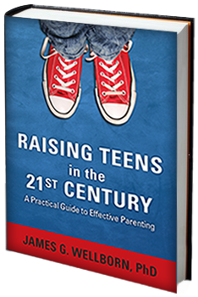
Resources
www.DrJamesWellborn.com
Articles tab
Parenting Teens Newsletter
www.drjameswellborn.com/newsletter
Parent & Teen Resources
www.JamesGWellbornPhD.com

